Slide 1

Block coding Developer
Session - 33
Build An App To Compare Two Words

Slide 2

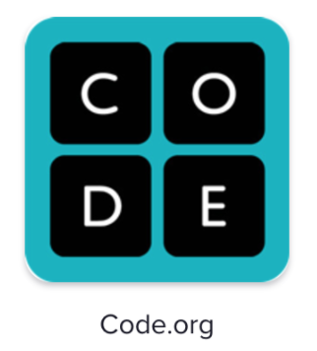
Recall…
What we have learnt in last session
What challenges you are facing

Slide 3
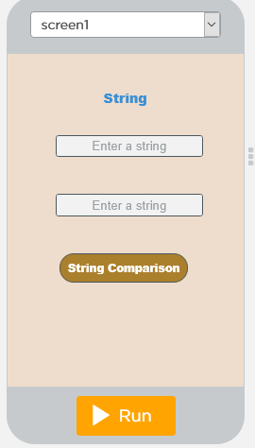
String Comparison…
We will Learn today:
What is a String?
What is String Comparison?
How to compare two string.

Slide 4
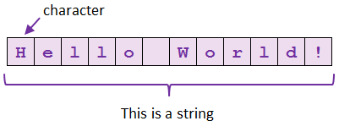
What is a String?
String is a group of characters

Slide 5
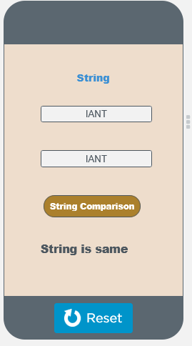
What is String comparison?
String compares two strings and is true if they are the same (corresponding characters are identical)
But is false if they are not equal

Slide 6
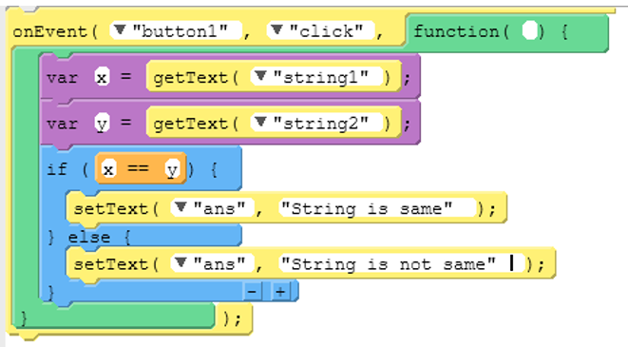
How to compare two strings…

Slide 7
Output – String Comparison

Slide 8
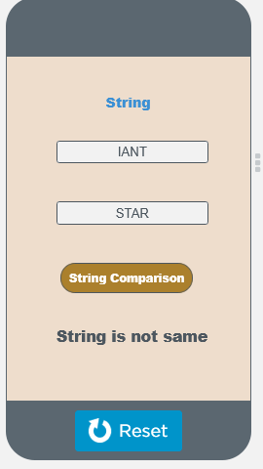
Output – String Comparison

Slide 9

Summary…
String Comparison
How to compare two strings in
App Lab

Slide 10
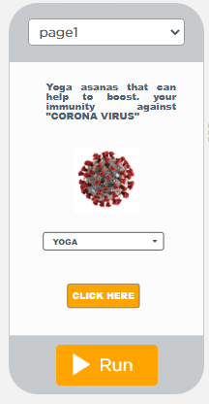
Next Session…
How to build an utility App

